Slide 1
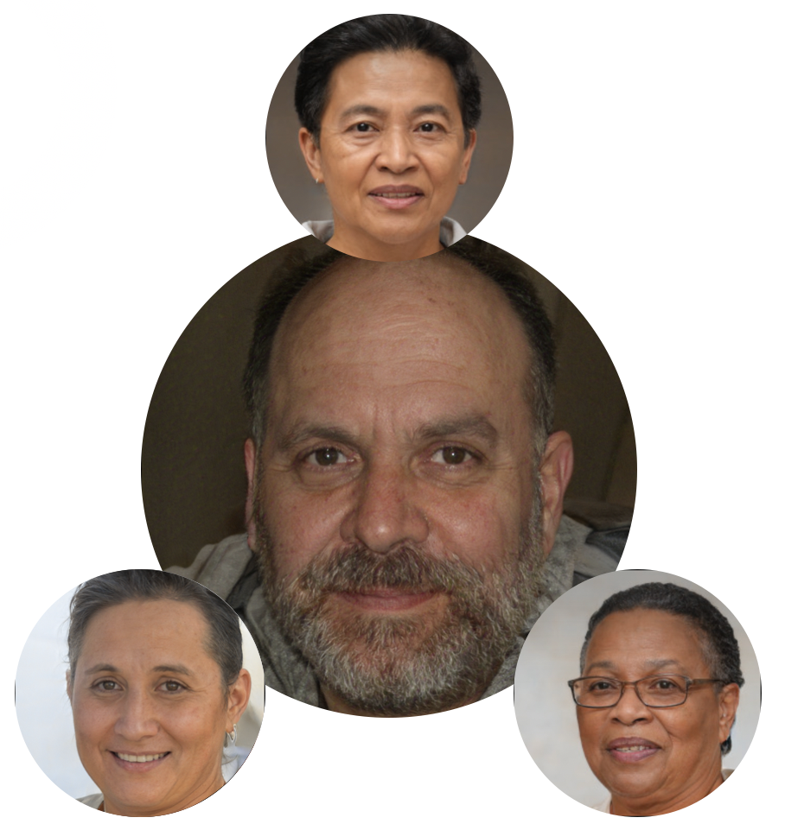
Dav (David, Davu, Davida)
Introduction:
Background/interests:
bdfgfgfhfbjgf
Access to Reliable Technology: Dav has spotty access to reliable devices with reliable internet access, so relies mainly on a mobile phone for internet access. Dav also often uses shared devices or public devices to get work done. This affects how, when, and why Dav uses technology.
Communication Literacy/Education/Culture: Dav went to school in a low-SES community which offered only a basic education. Now Dav rarely chooses to read lengthy or complex text (e.g., newspapers), and some cultural/literary allusions are unfamiliar to Dav. Although the school had a few older computers, it offered little technology education.
Attitudes toward Technology Risks: Dav’s life is crowded, so they rarely have spare time. So Dav is risk-averse about using unfamiliar technologies that they might need to spend extra time on, even if the new features might be relevant. Dav instead performs tasks using familiar features, because they're more predictable about what Dav will get from them and how much time they will take.
Technology Privacy and Security: Dav is very protective of their personal information, like their location and identity. Dav’s caution stems from their privacy/security being particularly at risk because of having to share devices, prior negative experiences with high surveillance, prior experiences with credit card/identity theft, etc.
Perceived Control and Attitude toward Authority:
Dav does not expect to have much influence over technology’s outcomes. Instead, Dav views technology as if it represents an authority figure, so expects technology to treat Dav as other authority figures do.
Technology Self-Efficacy: Dav’s prior experiences and education have produced a lower technology self-efficacy than their peers about using unfamiliar technology features. If problems arise with technology, Dav often blames themselves for these problems. This affects whether and how they will persevere with a task.

